Slide 1

Notes:
The Alliance for Community Health Worker Employers
Welcome you to today’s presentation Panel Discussion: Demystifying Pathways to CHW Certification.
Like to thank Mario Bueno, Executive Director of Progreso Latino who will serve as our facilitator for today’s learning session.
1

Slide 2

Business Models to Grow and Sustain CHW Programs
Objectives:
Understand Various Funding sources
Explore Critical Factors such as Personnel Costs, Supervision and Operational Costs
Apply Practical Tools to Simplify the Budgeting Process
Notes:
We hope you leave here with a better understanding of:
-

Slide 3




Carl Rush
Sam Salganik
Ben Tiensvold
Presenters
Notes:
Carl Rush
Senior Technical Advisor, National Association of Community Health Workers San Antonio, Texas
Carl H. Rush, MRP (he, his) has specialized in policy and workforce development for community health workers (CHWs) since 1996. He has advised CHW policy initiatives in more than 25 individual states; he is currently advising on Medicaid SPA discussions for CHW services in seven states. He was a lead author on HRSA’s 2007 CHW National Workforce Study, and co-lead on the CHW Core Consensus (C3) Project (2013-16). Carl completed two national policy studies with the CDC, on CHW certification and workforce development (WD) strategy (2014-17), and is advising CDC’s new follow-on study of WD policy. He is a consultant to National Academy for State Heath Policy (NASHP) on their current CHW policy learning community TA project, and the Envision (CDC 2110) TA effort for “2109” grantees. He was on a steering committee (2015-19) that became the inaugural Board of Directors for the National Association of CHWs (NACHW) and is currently serving as a policy consultant to NACHW under contract.
Sam Salganik
Sam Salganik is the Executive Director of RIPIN, Rhode Island’s largest employer of certified Community Health Workers (CHWs), with about 100 certified or emerging CHWs on staff . RIPIN is built on a peer model, with most of its board and staff being parents are caregivers to a loved one with a disability, and helps Rhode Islanders navigate special education, health care, and healthy aging. Sam has been at RIPIN since 2014, and Executive Director since 2019. He has also served in State government and currently serves on several statewide policy advisory committees. Sam has a bachelor’s from Brown University and a J.D. from Columbia University.
Ben Tiensvold, Executive Director
Community Health Worker Collaborative of South Dakota
Ben has served as the lead contact for the CHWSD since its inception in January 2020. He has led the CHWSD through significant growth over the first three years, in part due to the CDC Health Disparities Grant funding the SD Department of Health received in June of 2021. Additionally, for the past nine years, Ben served as the Coordinator for the South Dakota Diabetes Coalition (SDDC). Ben is passionate about the CHW profession and works to be an ally for all CHWs. Ben previously worked with the SD Department of Health in 2015 and 2016 on Community Health Worker-related introductory projects. This work led to key recommendations for CHWs (which the South Dakota Department of Social Services then used to develop CHW Medicaid reimbursement). Ben has Bachelor of Arts degrees in Communication Studies and Public Relations from Southwest Minnesota State University and recently completed a Graduate Certificate in Public Health from New Mexico State University.

Slide 4
MEDICARE PHYSICIAN FEE SCHEDULE HCPCS CODES FOR AUXILIARY SERVICES
Community Health Integration (CHI) | Principal Illness Navigation (PIN) | Principal Illness Navigation Peer Support (PIN-PS)
Reimbursement for labor for addressing Health Related Social Needs (HRSNs) | Reimbursement for providing health navigation services for persons with serious illness expected to last at least 3 months | Reimbursement for peer support services provided to a persons with a behavioral health/SUD
Personnel: Community Health Workers, Social Workers, Health Coaches other staff with training | Personnel: Community Health Workers, Social Workers, Health Coaches, other staff with training | Personnel: Peer support workers who have met the state or SAMHSA national training requirements for peer support workers
Courtesy of Freedmen's Health
Notes:
Freedmen’s Health

Slide 5
CHI HCPCS | Descriptor | Non-Facility Rate | Facility Rate
G0019 | Community Health Integrations Services (CHI) SDOH 60 min | $82.79 | $50.62
G0022 | Community Health Integration Services ( CHI) add ea.30 min | $51.58 | $35.33
G0511 (FQHCs/RHCs) | Each eligible CHI service | $71.70(Flat Fee)
PIN HCPCS | Descriptor | Non-Facility Rate | Facility Rate
G0023 | PIN Service, 60 min per month | $82.79 | $50.62
G0024 | PIN service add ea. 30 min | $51.58 | $35.33
G0511(FQHCs/RHCs) | Each eligible PIN service | $71.70(Flat Fee)
PIN-PS HCPCS | Descriptor | Non-Facility-Rate | Facility Rate
G0140 | PIN Service, 60 min per month | $82.79 | $50.62
G0146 | PIN-PS, Peer Support add ea. 30 min | $51.58 | $35.22
G0511 (FQHCs/RHCs) | Each eligible PIN-PS service | $71.70 ( Flat Fee)
*RI Statewide Rates effective March 9, 2024
Notes:
*Freedmen’s Health

Slide 6


Business Models to Grow and Sustain CHW Programs
RI CHW Employer Alliance
June 28, 2024
CHW Sustainability:
Sources and Models
Carl H. Rush, MRP
Community Resources, L:LC
San Antonio, Texas

Slide 7
Scaling and “sustainability” require:
Sustainable financing
Infrastructure/supports
Organizational readiness
Reflective (trauma-informed) supervision
Workforce development investments
Robust evaluation
Notes:
Infrastructure/supports: IT, expenses
Organizational readiness, including impact on organizational culture
Reflective (trauma-informed) supervision
Workforce development investment, including career advancement
Robust evaluation

Slide 8
“Sustainable financing” has been scarce
Sustainable = long-term, independent of grants
Public health lacks appropriate ongoing revenue streams
Employers may also incorporate CHWs into general budgets based on internal ROI
Notes:
Systems of budgeting for CHW positions which are not dependent on applying for program or project grants or contracts
May be achieved either through
ongoing revenue streams that explicitly provide for or “cover” CHW services or
incorporating CHWs into ongoing budgeting within the employer’s overall revenue picture without a specific revenue source being dedicated to CHW services
Avoid using the shorthand “Medicaid reimbursement for CHWs” –
fee-for-service may be the hardest way to pay for their activities

Slide 9

Taking the CHW Workforce “to Scale”
How many CHWs does a state or community “need?”
How many do we have now?
  Non-licensed workers are hard to enumerate
  Official numbers (BLS) likely not reliable

Slide 10
Basic provisions of new Medicare regulations
Community Health Integration (CHI) services
  can cover wide range of activities
  provided by “auxiliary personnel… incident to” clinical care; community health workers (CHWs) are emphasized
Must be ordered by “billing provider” during an “initiating visit” – provider also responsible for general supervision and billing
Claims may only be submitted by one billing provider for a given patient; provider must be treating patient on ongoing basis
Providers encouraged to partner with community-based organization (CBOs), but CBOs cannot bill directly

Slide 11
Billing and rates
Billing on monthly basis: $79 for first hour, $49 each additional half hour in month, rates vary by state - no limit (HCPCS G0019, G0022)
  Lower rates for services provided in hospital or other facility ($49 and $34)
  FQHCs/RHCs: $78 flat fee per service (G0511)
Patient consent required, can be verbal (if documented in patient record)
Claims submitted first to Medicare Administrative Contractor, except for individuals covered by Medicare Advantage plans (Part C)
  Remaining authorized charges not reimbursed by Medicare can be billed to private Medicare Supplement plan or Medicaid

Slide 12
Cost sharing: potential issue?
Original Medicare requires 20% co-pay for most services including CHI
  Providers are not permitted to waive co-pays
  Could be removed if CHI services defined as preventive
Medicare Supplement (“Medigap”) and Medicare Advantage plans, including plans for duals (D-SNPs and C-SNPs) generally cover cost-sharing
  Medicaid required to cover co-pays for dual eligibles, but states may object

Slide 13
https://www.cms.gov/training-education/medicare-learning-network/compliance/mln9201074

Slide 14
Other potential funding sources
State-created special tax levy on revenues of health insurers (MCOs) and/or major provider systems
Nonprofit hospitals ”community benefits” funds
Federal block grants
Federal categorical programs: CDC, HRSA, SAMHSA, ACL
  Pooling of funds across silos?
  Some of these programs do not currently allow spending on CHW salaries
DoT “mobility managers” program

Slide 15
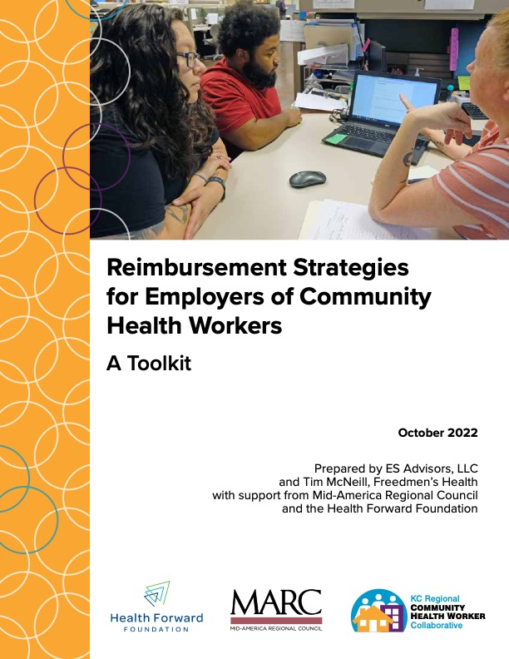




https://www.marc.org/sites/default/files/2022-11/CHW_Sustainability_Toolkit_FINAL_10-11-22.pdf

Slide 16
Blended and braided funding
Both approaches combine resources from multiple payers
  May be used by a single employer independently or by a community-level system, e.g., a “community care hub”
“Blended” means all payers accept a common payment structure and a shared reporting/accountability structure
“Braided” means employer reports separately to each payer based on a separate reporting system and separate objectives/metrics

Slide 17
Core features of the Pathways model
Community HUB manages partnerships, assigns referrals to CHWs from clinical providers and invoices payers
CHWs employed primarily by CBOs
CHWs assess family situation and risks, and negotiate action plan
Pathways are protocols used to resolve specific situations/needs
Progress on Pathways is used to invoice payers
Payers include Medicaid, housing authorities, school systems, food programs, United Way etc.

Slide 19


Thank you! - ¡Gracias! - Obrigado!

Slide 20
Business Models to Grow and Sustain CHW Programs
Expenses
Alliance for CHW Employers
Learning Session, June 28, 2024
Sam Salganik, Executive Director
Salganik@ripin.org

Slide 21

What is RIPIN?
Peer-led
Special education, health care, and healthy aging
100 emerging or certified CHWs

Slide 22
Revenue
Expenses
Budgeting

Slide 23
Typical Expenses
Wages: Salary
Benefits/Fringe: Payroll taxes, health insurance, retirement, workers comp premiums, PTO, etc.
Supervision: Salary and other expenses associated with program supervision staff
Other Direct Expenses: Rent, equipment, software licenses, telephony, mileage, training, supplies, etc.
Indirect: Cost of organizational HR, Finance, and other shared functions

Slide 24
RIPIN Example
Expense Item | Explanation | Cost Factor | Cost
Wages | Assumption to make math easy! (Not necessarily reflective of RIPIN CHW pay!) |  | $20/hour
Benefits / Fringe | Employer payroll taxes, health insurance, retirement, workers comp, PTO, etc. | 25% of wages | $5/hour
Supervision | Span of control of 5-7 CHWs per supervisor, 10-15 CHWs per manager, 30-40 CHWs per director. | 25% of wages | $7/hour
Other Direct | Rent, technology, equipment, licensing, mileage, training, supplies, etc. | 25% of wages | $5/hour
Indirect | At RIPIN, this covers only HR, finance, and front-desk reception. | 15% of total direct | $5.55/hour
TOTAL |  |  | $42.55/hour

Slide 25
Deep Dive - Supervision
Director
Manager
Manager
Manager
Manager
Six CHWs
Six CHWs
Six CHWs
Six CHWs
$85k
4 x $60k = $240k
24 x $40k = $960k
$325k / $960k = 34% cost of supervision
Wages in these examples are hypothetical and do not represent RIPIN pay scales.

Slide 26
Deep Dive - Supervision
Director
Manager
Manager
Manager
Manager
12 CHWs
12 CHWs
12 CHWs
12 CHWs
Manager
12 CHWs
Manager
12 CHWs
$85k
6 x $60k = $360k
72 x $40k = $2,880k
$445k / $2,880k = 15% cost of supervision
Wages in these examples are hypothetical and do not represent RIPIN pay scales.

Slide 27
Deep Dive - Supervision
Director
Manager
Manager
Manager
Manager
Six Staff –Other funding
Six Staff – Other funding
Six Staff – Other funding
Six CHWs – Other funding
One New CHW
What is the cost of supervision for this new CHW?
And what about the allocable cost of indirect?

Slide 28
Hidden Cost? – Unbillable Time
Nobody bills out 100% of their time!!
Billable Activity
Direct communication with clients
“Collateral” work on behalf of clients
  Services “on behalf of an individual beneficiary . . . not delivered in that beneficiary’s presence”
  E.g. calling providers, calling shelters, doing research, etc.
Non-Billable Activity
Travel time
Outreach
Team meetings, supervision, networking, trainings, PD
Screening clients who do not engage or do not have billable coverage
Documentation
Holidays & PTO
Provider Manual and FAQs available at:
https://eohhs.ri.gov/providers-partners/provider-manuals-guidelines/medicaid-provider-manual/community-health-worker

Slide 29
RIPIN Billable Time Example - Cedar
CHW-led program supporting Medicaid-enrolled children with disabilities.
Not billed through CHW benefit. But time-tracking is important component of billing.
Supervisory and support staff do lots of patient screening, outreach, billing data support, etc. Once CHWs are working with a child/family, they are already pre-screened and eligible.
Support mostly phone-based.
Six CHWs.
CHW Billiable Time / Total Paid Time
13-Week Period (3/18/24->6/14/24)
CHW 1 – 49%
CHW 2 – 51%
CHW 3 – 37%
CHW 4 – 56%
CHW 5 – 59%
CHW 6 – 80%
Average = 55%
None had unpaid leave over this period.
CHWs took different amounts of PTO.
We also get some billable time out of the leadership / support team in this program.
Culture!!
How important is the program design to the billable time ratio?

Slide 30
Reminder
Expense Item | Explanation | Cost Factor | Cost
Wages | Assumption to make math easy! (Not necessarily reflective of RIPIN CHW pay!) |  | $20/hour
Benefits / Fringe | Employer payroll taxes, health insurance, retirement, workers comp, etc. | 25% of wages | $5/hour
Supervision | Span of control of 5-7 CHWs per supervisor, 10-15 CHWs per manager, 30-40 CHWs per director. | 25% of wages | $7/hour
Other Direct | Rent, technology, equipment, licensing, mileage, training, supplies, etc. | 25% of wages | $5/hour
Indirect | At RIPIN, this covers only HR, finance, and front-desk reception. | 15% of total direct | $5.55/hour
TOTAL |  |  | $42.55/hour
$42.55/hour x 2,080 hours/year = $88,504 per year

Slide 31
Billable Time Sensitivity
$42.55/hour x 2,080 hours/year = $88,504 per year
Medicaid Rate: $50.76/hour
($64.56 for new patients, $18.60/participant for groups)
$50.76 x 2080 hours = $106,000
$50.76 x 2080 x 70% = $74,000
$50.76 x 2080 x 60% = $63,000
$50.76 x 2080 x 50% = $58,000
Medicare Rate: $103.16/hour
($82.79 for first hour) (non-facility)
(Basically only available for Medicare clinical Part B providers)
$100 x 2080 hours = $208,000
$100 x 2080 x 70% = $145,000
$100 x 2080 x 60% = $124,800
$100 x 2080 x 50% = $104,000
Costs to keep in mind when relying on billing revenue:
Program data systems, billing systems, oversight, finance
Start-up costs
REVENUE RISK

Slide 32
Blended Funding to Expand CHW Capacity
Director
Manager
Manager
Manager
Manager
Six Staff –Other funding
Six Staff – Other funding
Six Staff – Other funding
Six CHWs – Other funding
One New CHW
Can the existing six CHWs bill out some of their time? Can this support new capacity?

Slide 33
Key Takeaways
At RIPIN, the “full cost” of employing a CHW (including wages, fringe, supervision, other direct costs, and indirect) is about 2.12 times the CHW’s wage. That multiplier will vary by organization.
Supervision and indirect are key costs and they are real, but different organizations can view them differently.
If relying on billing CHW time to insurers, remember that nobody can bill 100% of their paid time. The percentage of time a CHW can bill will vary based on the program design.

Slide 34
Questions & Discussion?

Slide 35


SD Medicaid Reimbursement Data and Reimbursement Offset Calculator for CHW Positions

Slide 36
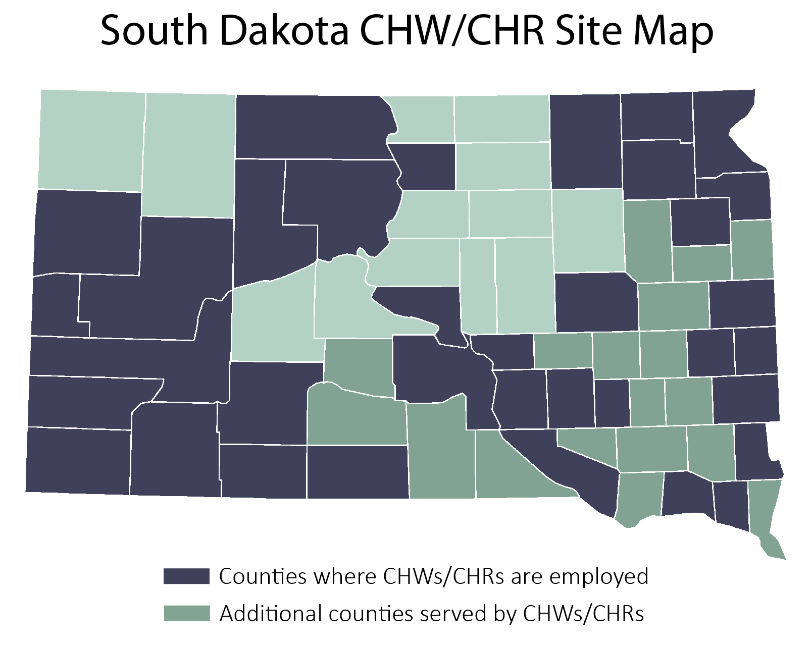
CHWS IN SOUTH DAKOTA
As of May 1, 2024
85 Tribal CHRs
165+ CHWs
~10 CHWs currently in training
SD Population – 900,000
RI Population – 1,094,000

Slide 37
MEDICAID REIMBURSEMENT IN NUMBERS

Slide 38
Reimbursement Rates by State
What’s the rate in RI?
NY - $70
SD - $64.86
CA - $53.42
IN - $53.12
AZ - $48.46
KY - $43.06
NV - $36.68
LA - $36.22
MI - $34.46
KS - $19.40
Rhode Island’s Hourly Reimbursement - $50.76 per hour

Slide 39
SD MEDICAID REIMBURSEMENT
Data – March 16, 2023– May 17, 2024
Processed Claims
Over 10,000 units have been paid through claims
$259,256.65 total in reimbursed claims
CHW Agencies Billing
15 agencies have billed so far, representing all 6 target organization types:
  Medical/Clinical
  FQHC
  Community-based organization
  EMS/CHW Program
  Dental Program
  CHR Program

Slide 40
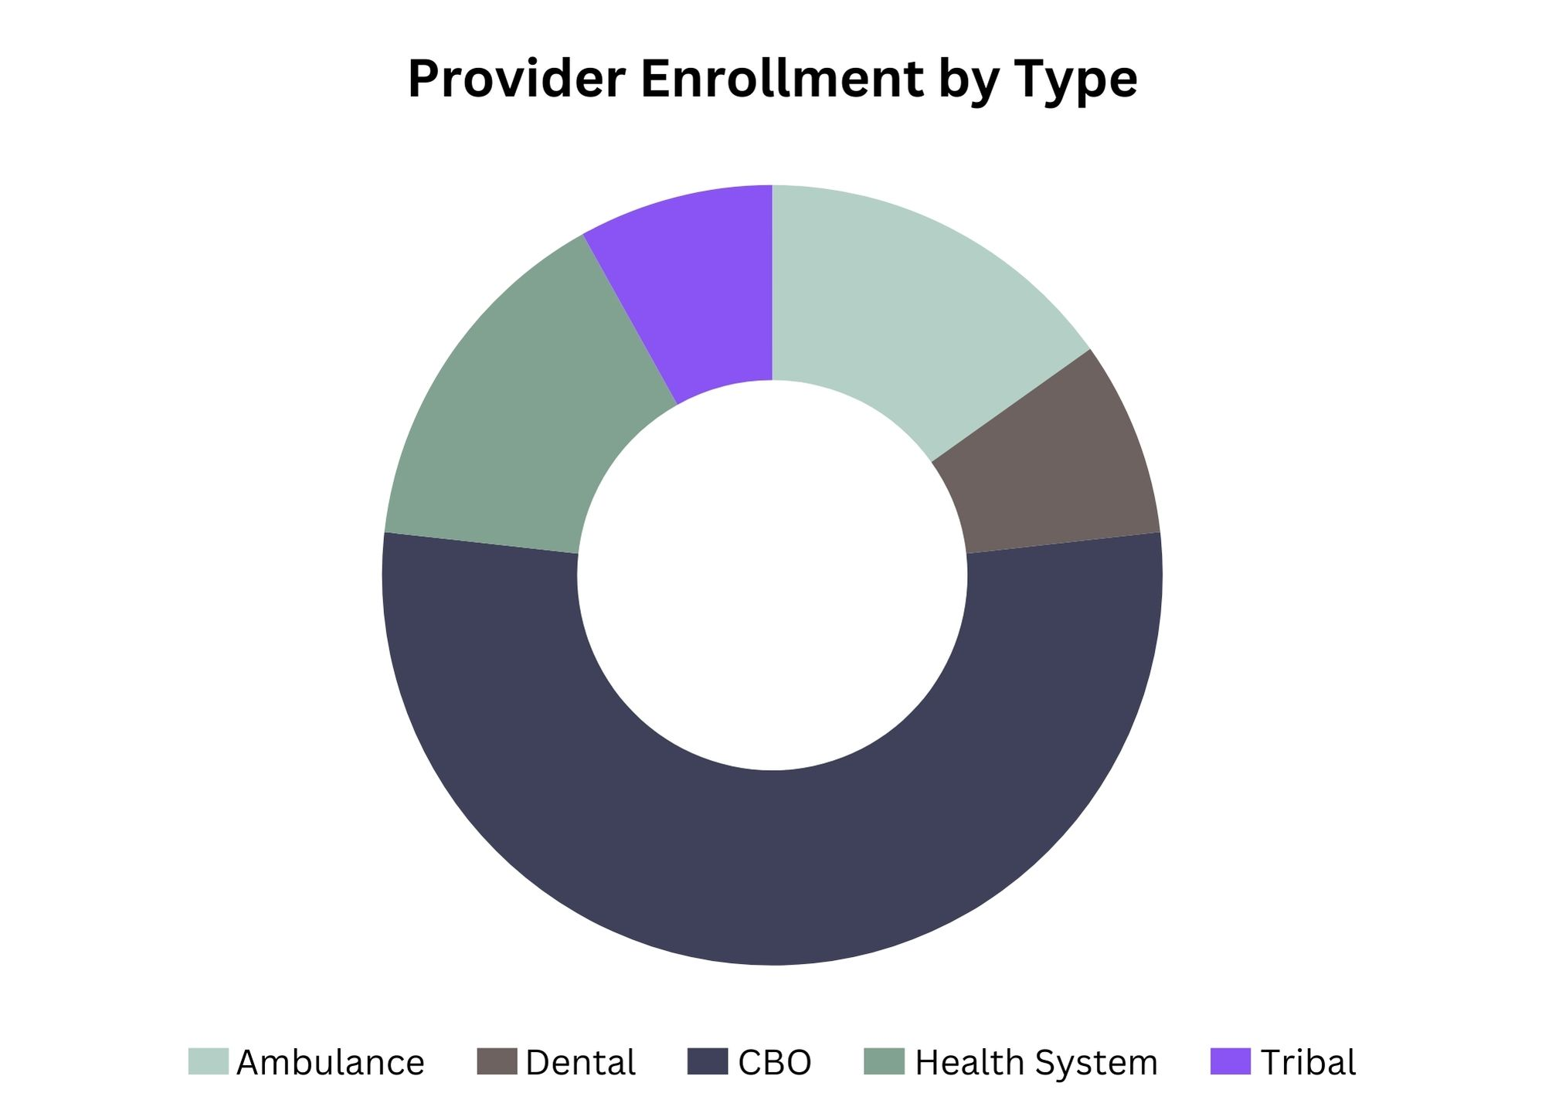
ORGANIZATIONS BILLING MEDICAID IN SD
Data – July 1, 2023 – April 18, 2024
CHW Agencies Billing After Receiving Provider Referrals
  N=41 organizations planning to bill Medicaid
  Half of these organizations seeking SD Medicaid reimbursement are CBOs

Slide 41
REIMBURSEMENT TO SUPPORT POSITIONS AND SUSTAINABILITY

Slide 42
REIMBURSEMENT = SUSTAINABILITY
Sustaining Wages and Programs
RI Hourly Reimbursement - $50.76 per hour
1 Hour Reimbursement Per Day
$50.76 / 8 hours = $6.35 per hour
2 Hours Reimbursement Per Day
$101.52 / 8 hours = $12.69 per hour
3 Hours Reimbursement Per Day
$152.28 / 8 hours = $19.04 per hour

Slide 43


REIMBURSEMENT = SUSTAINABILITY
The TIME is NOW!
THIS is more important than writing a grant – you only have to do it once and the reimbursement continues on and on and on and on. Find out what percentage of the population you currently serve is Medicaid eligible or Medicaid recipients.
Waiting to bill Medicaid for services is leaving money on the table for services already being provided!

Slide 44
CHW POSITION EXPENSES AND REIMBURSEMENT ESTIMATOR

Slide 45
Business Models to Grow and Sustain CHW Programs
These materials were developed for the Alliance for CHW Employers and are the authors' intellectual property. Please cite the Alliance for CHW Employers and the author when referencing any of these materials.
Alliance for CHW Employers
Learning Session, June 28, 2024

Slide 46




Alliance for Community Health Worker Employers
401-270-0101
Monday through Friday
8:00 AM – 5:00 PM
Alliance@ripin.org
Website: ripin.org/Alliance
Facebook: @RIPIN.ORG
Twitter/Instagram: @RIPIN_RI

